Slide 1
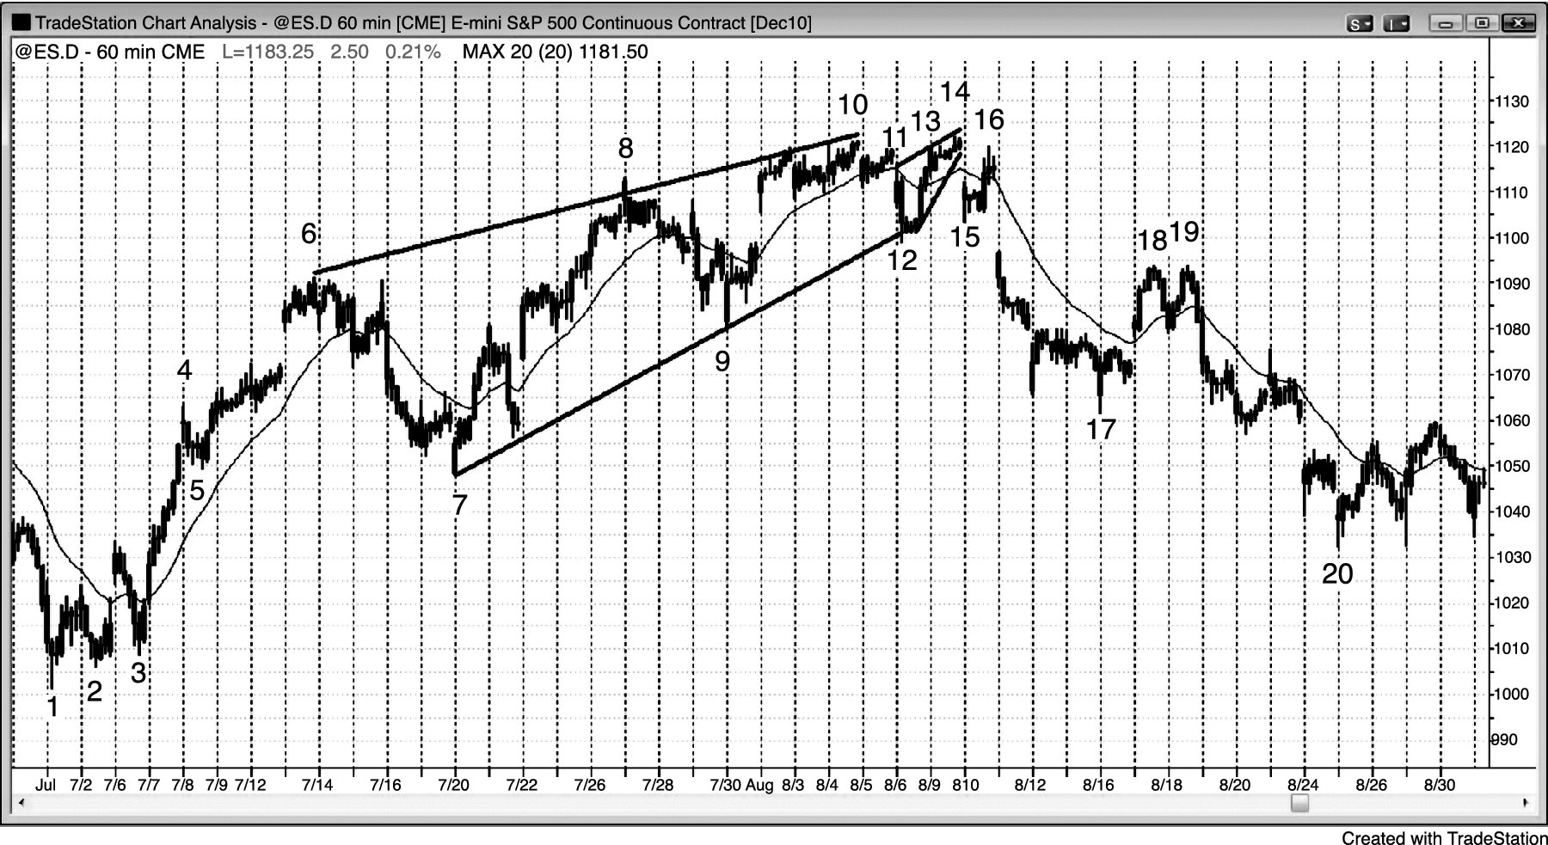
FIGURE 5.1 Wedge Top

Slide 2
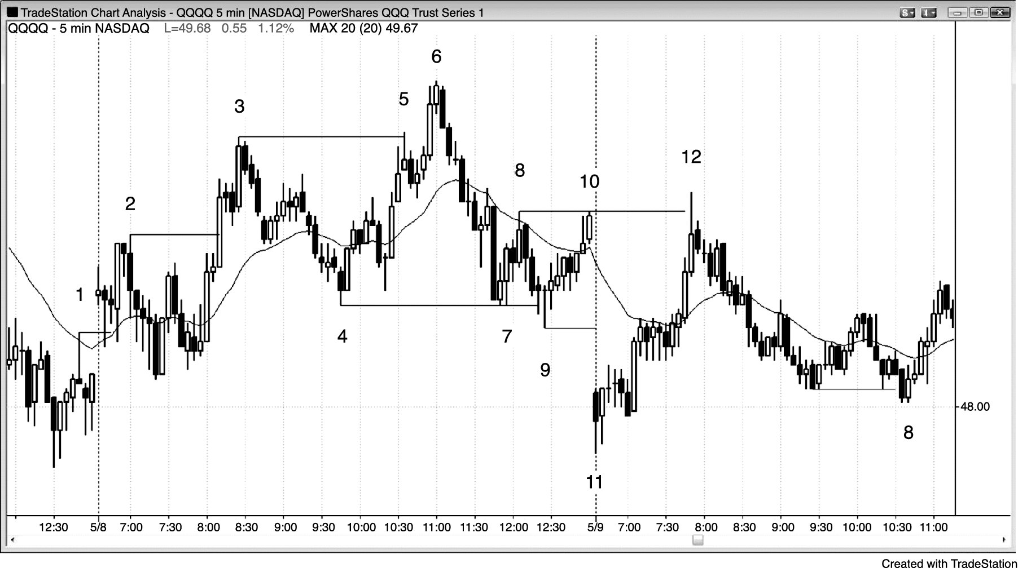
FIGURE 5.2 First-Hour Wedge

Slide 3
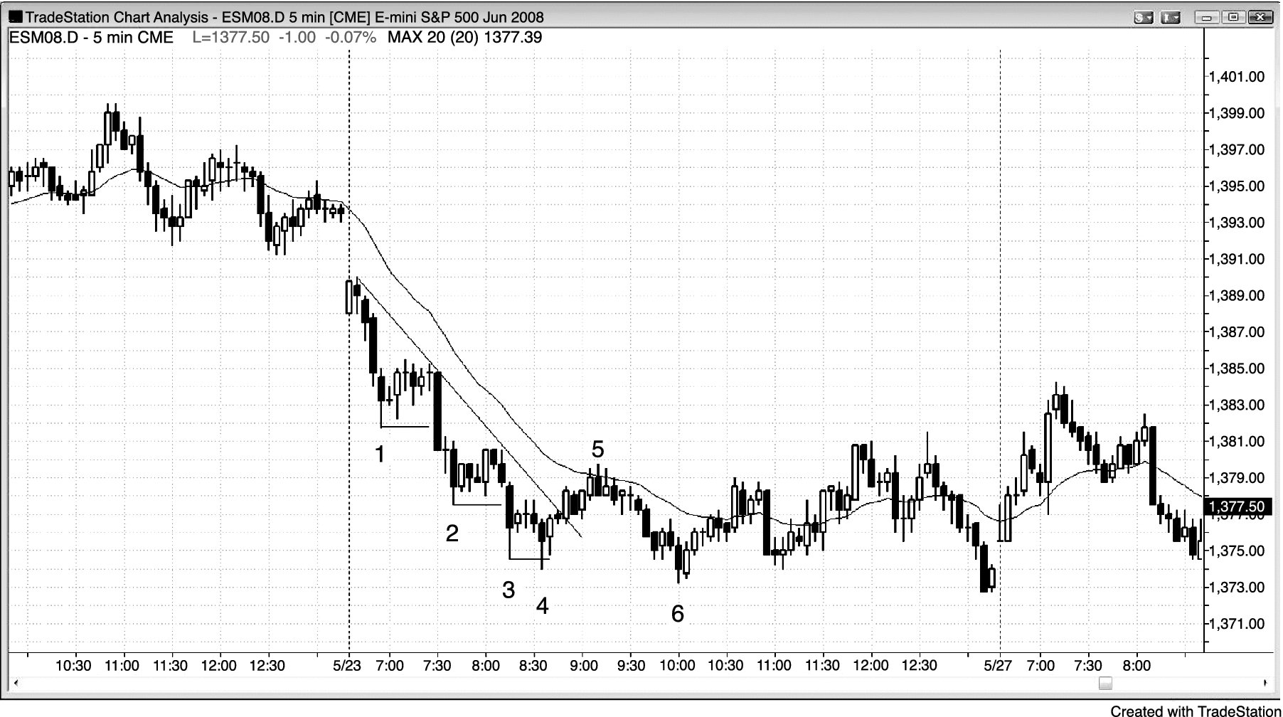
FIGURE 5.3 Shrinking Stairs

Slide 4
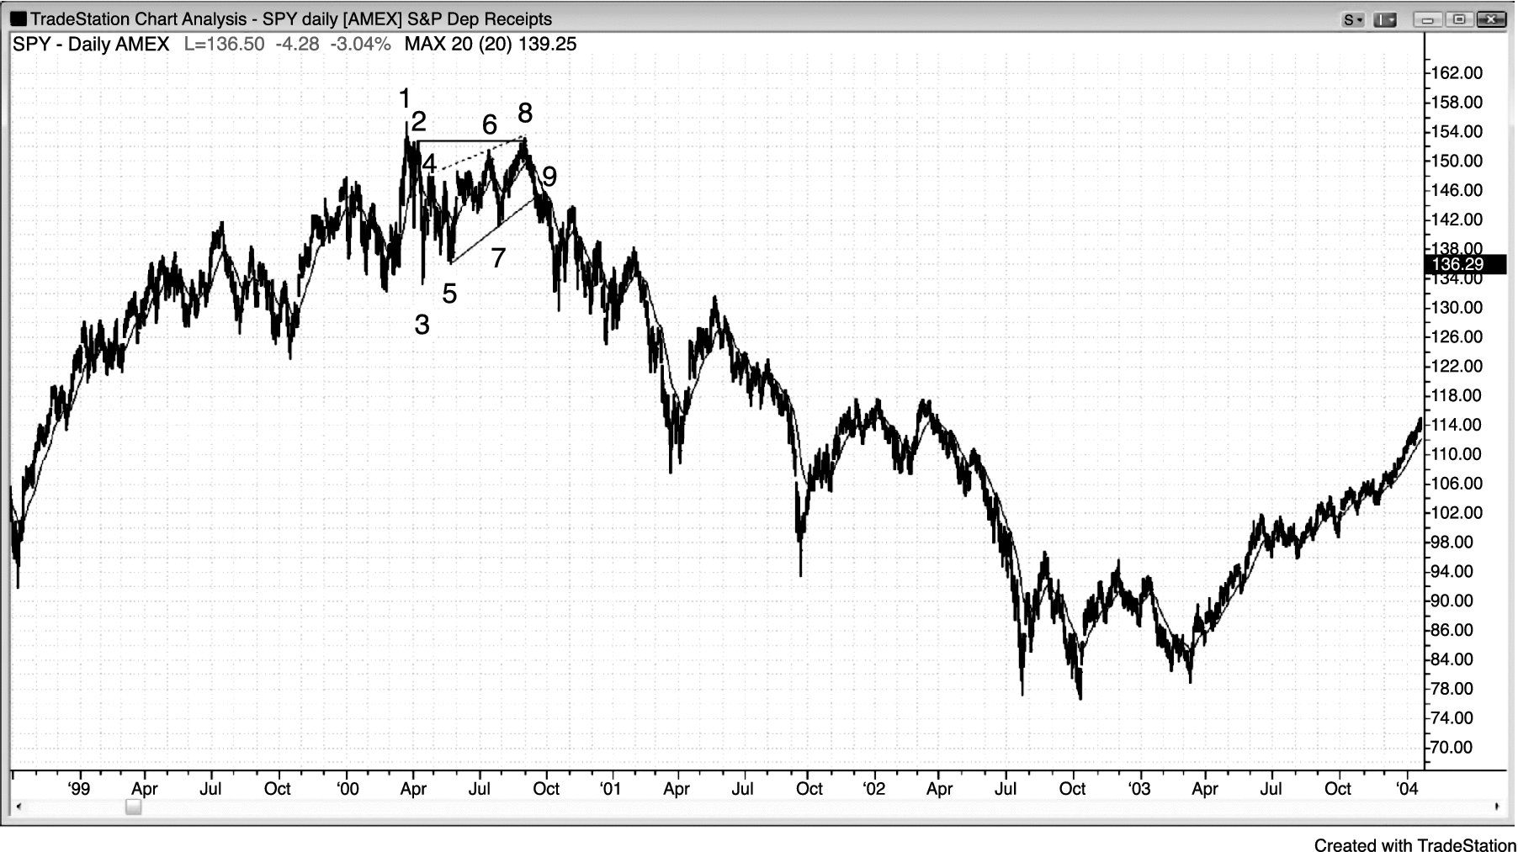
FIGURE 5.4 Wedge Lower High

Slide 5
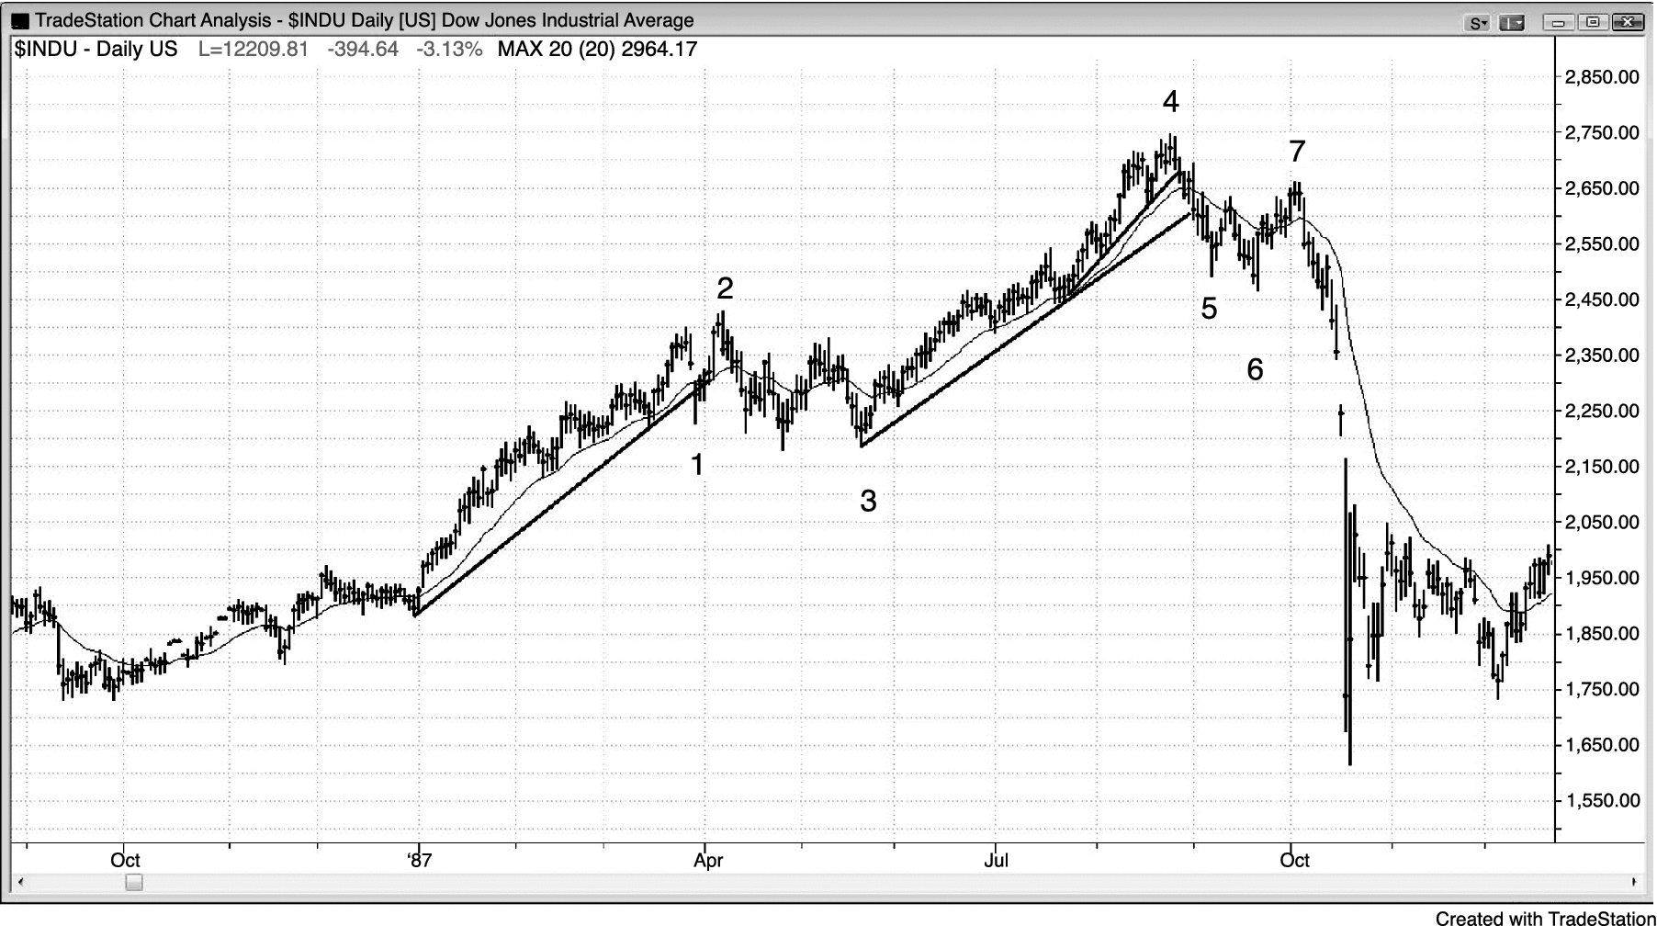
FIGURE 5.5 Wedge Lower High in the Dow

Slide 6
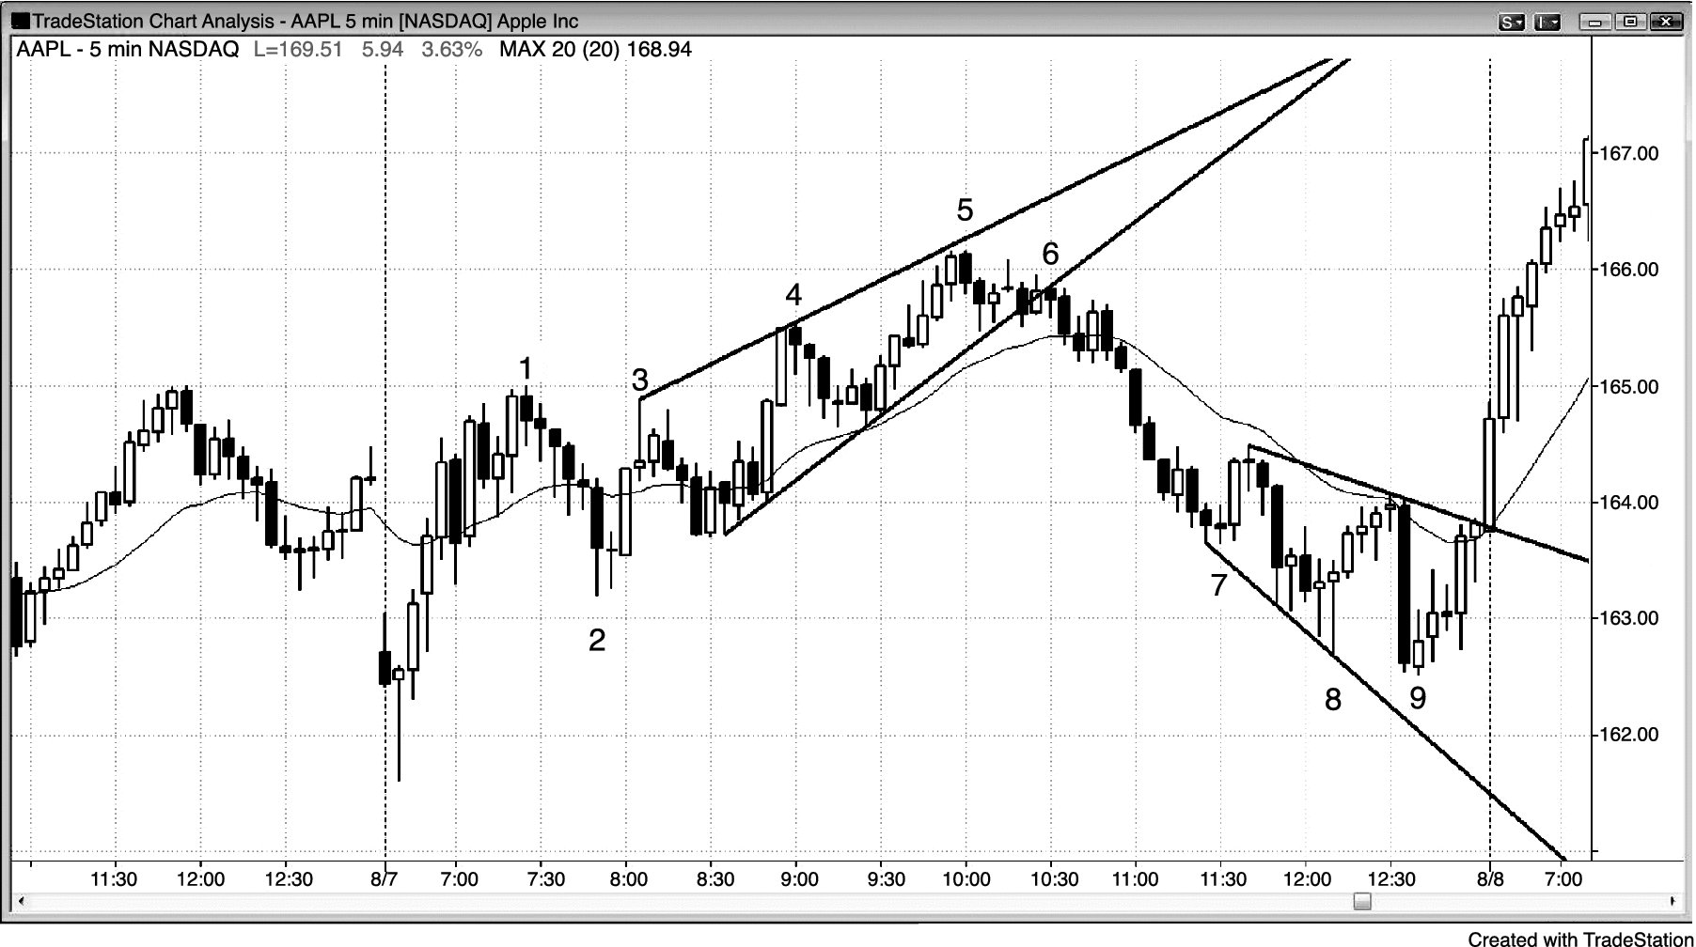
FIGURE 5.6 Reversal Just Shy of Trend Channel Line

Slide 7
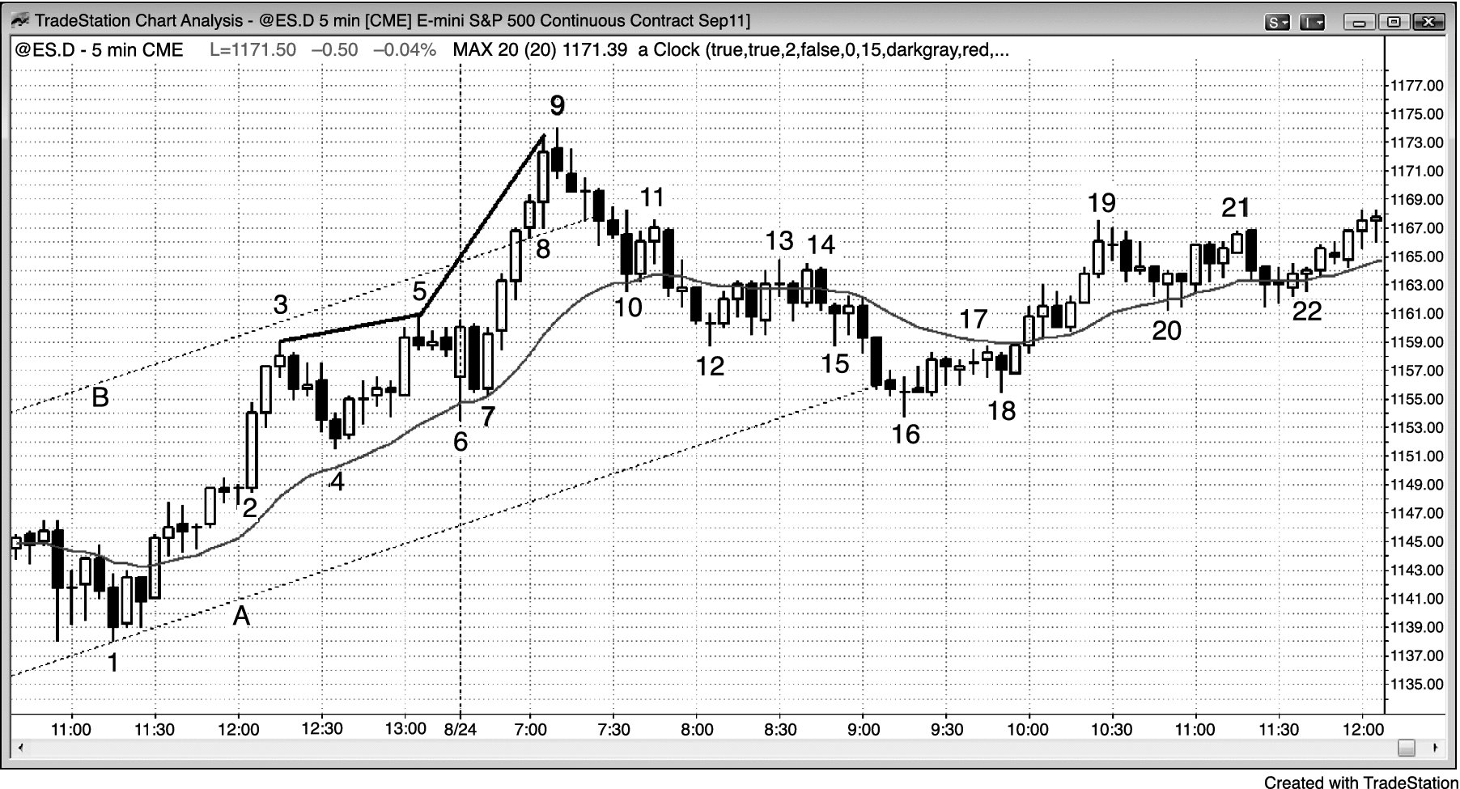
FIGURE 5.7 Parabolic Wedge

Slide 8
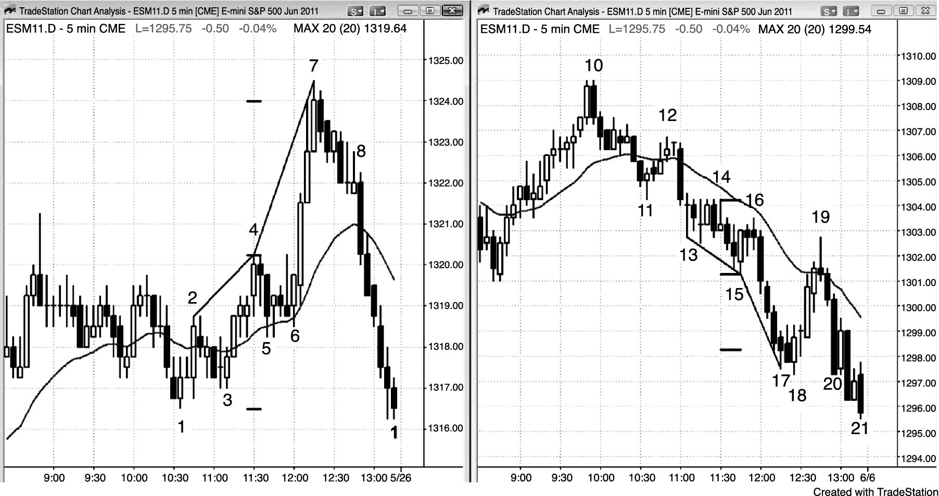
FIGURE 5.8 Bull and Bear Parabolic Wedges

Slide 9
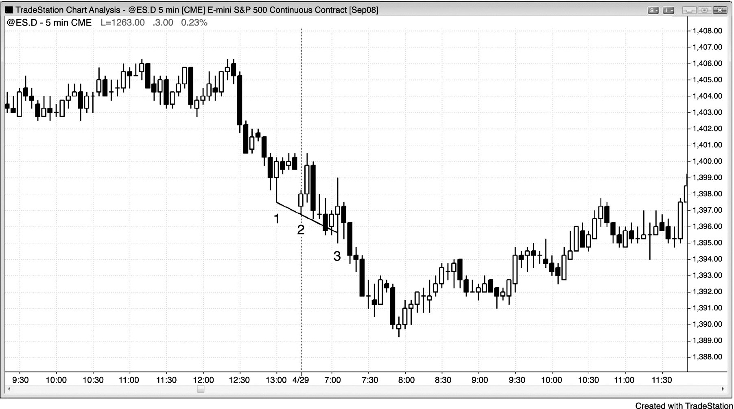
FIGURE 5.9 Failed Wedge

Slide 10
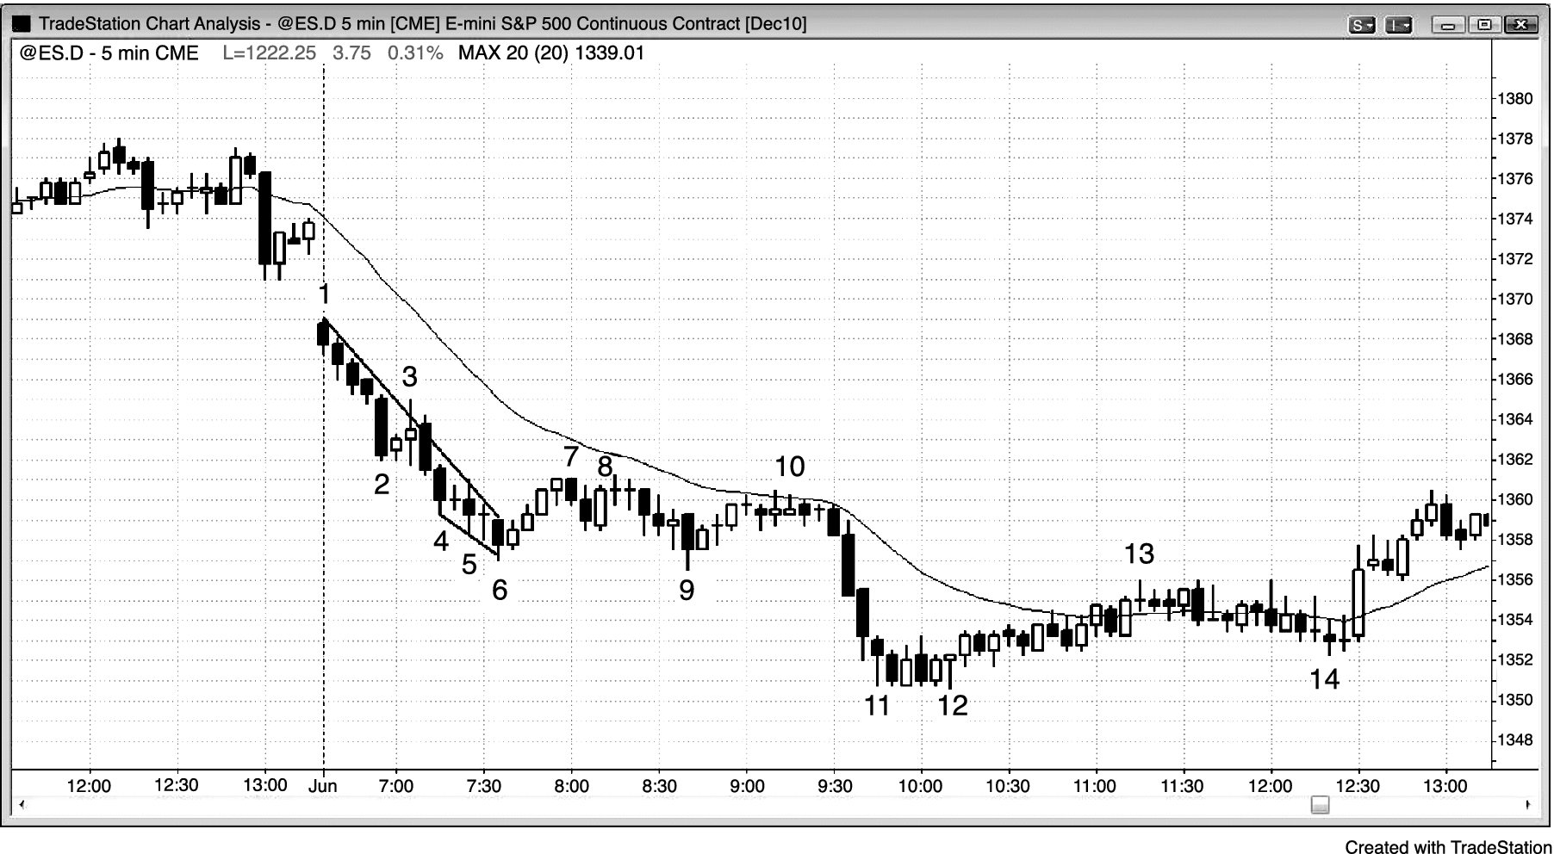
FIGURE 5.10 Wedge That Is Too Tight

Slide 11
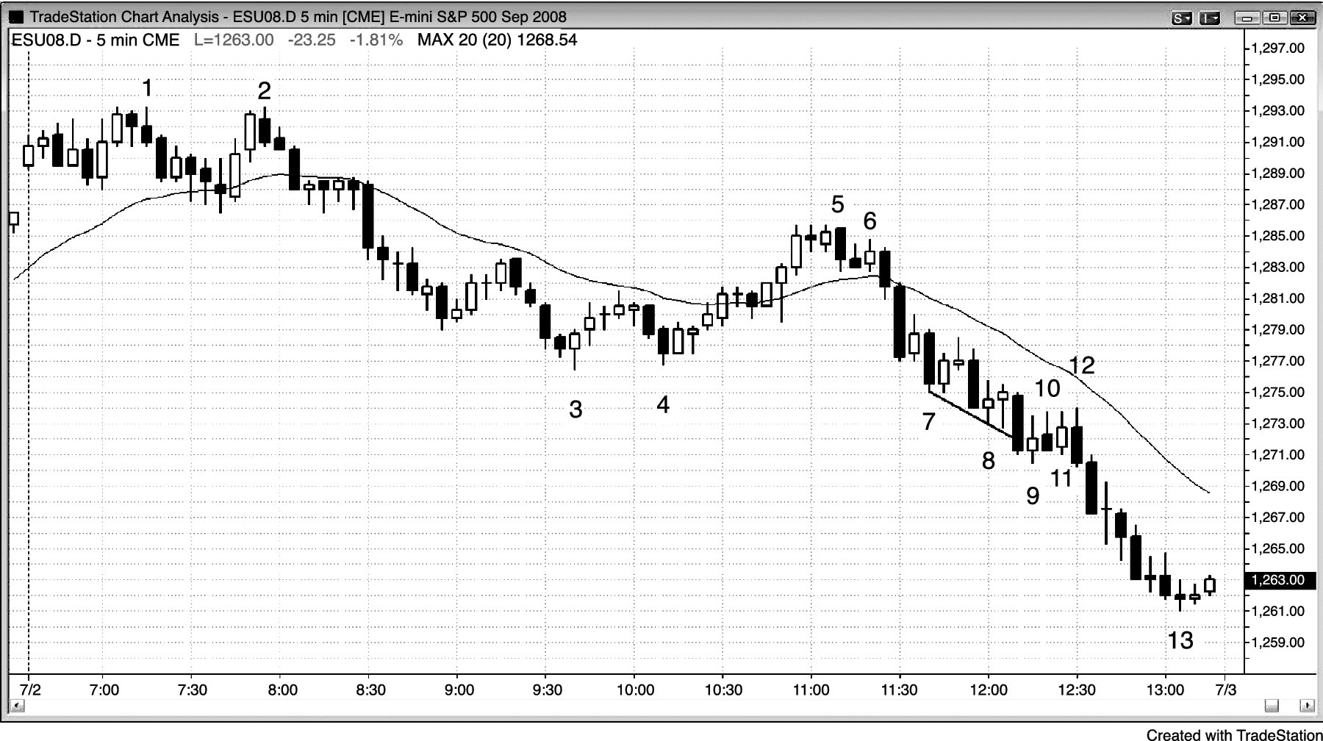
FIGURE 5.11 Wedge but Tight Channel

Slide 12
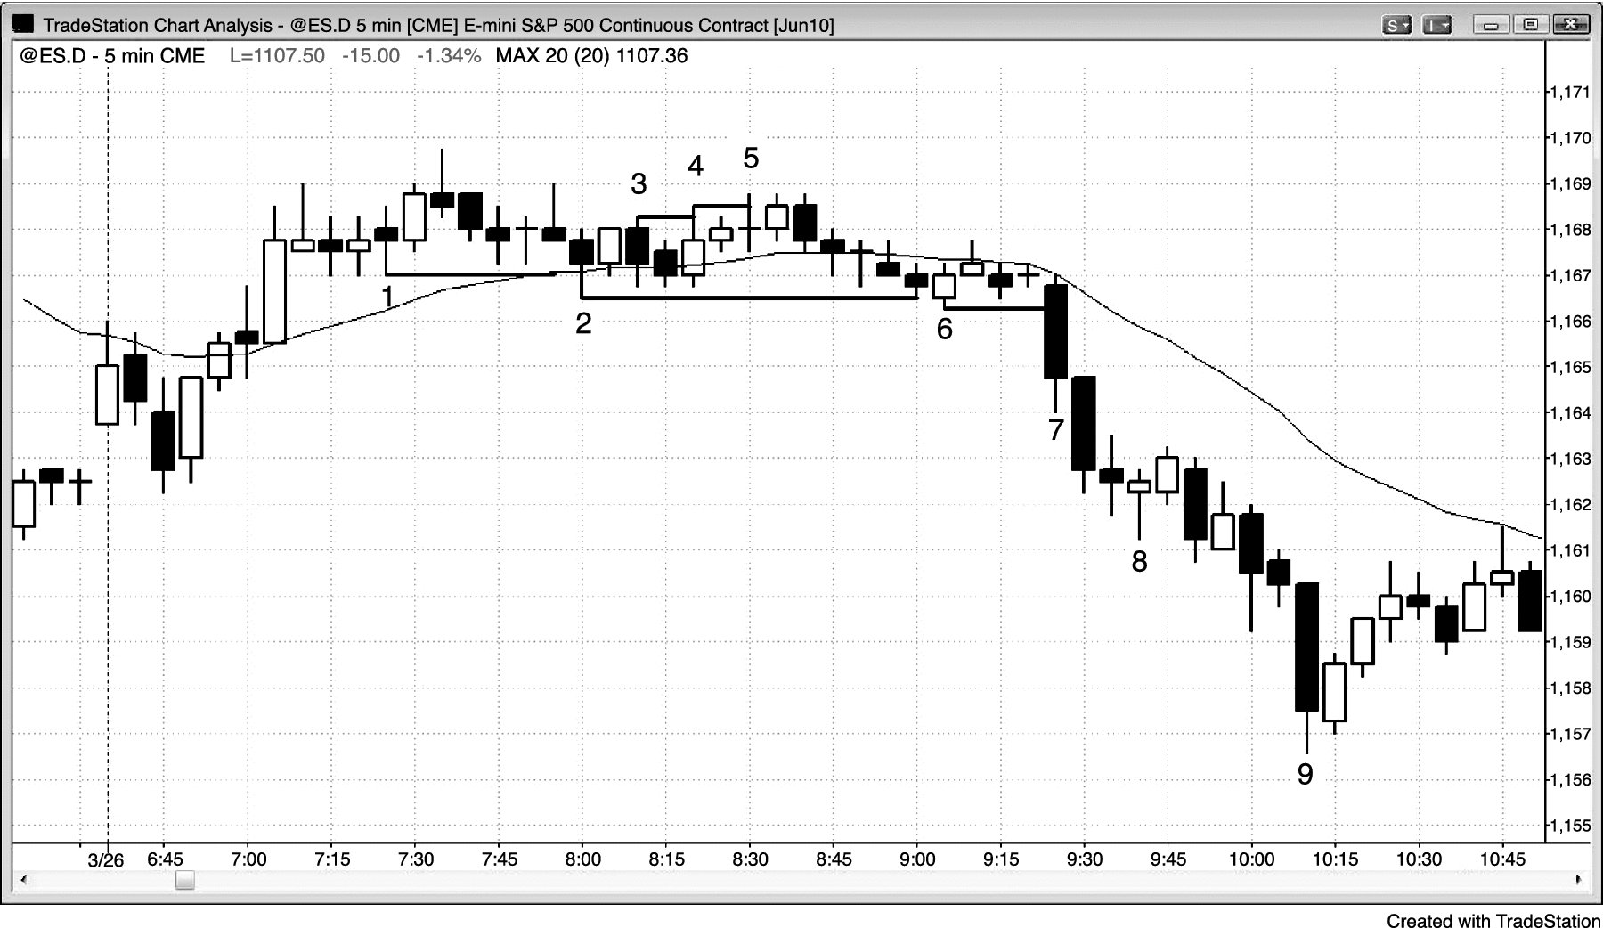
FIGURE 5.12 Successive One-Tick Breakouts

